Slide 1
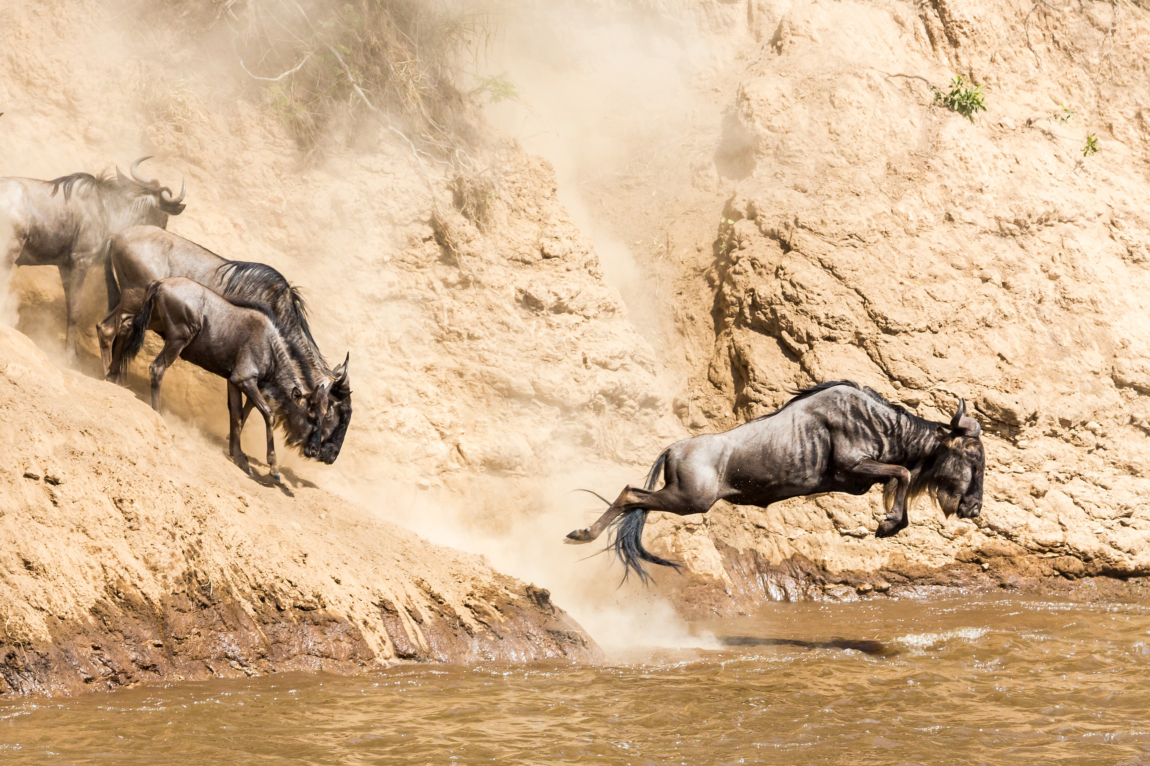








Introduction to Distance Sampling for Wildlife Population Monitoring
Wildlife Tourism College
Pardamat Conservation Area
16 – 20 September 2024
Award: 80NSSC23K1537

Slide 2
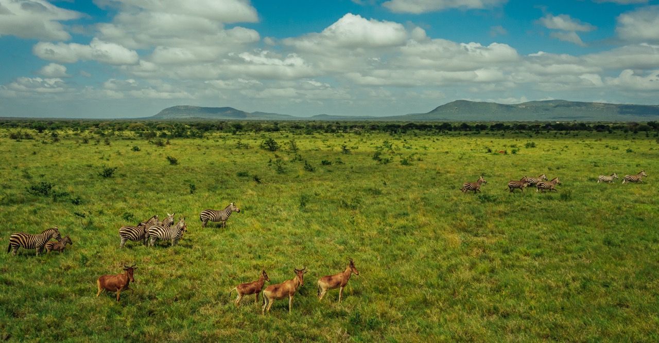
Q1: Why do we count wildlife?

Slide 3
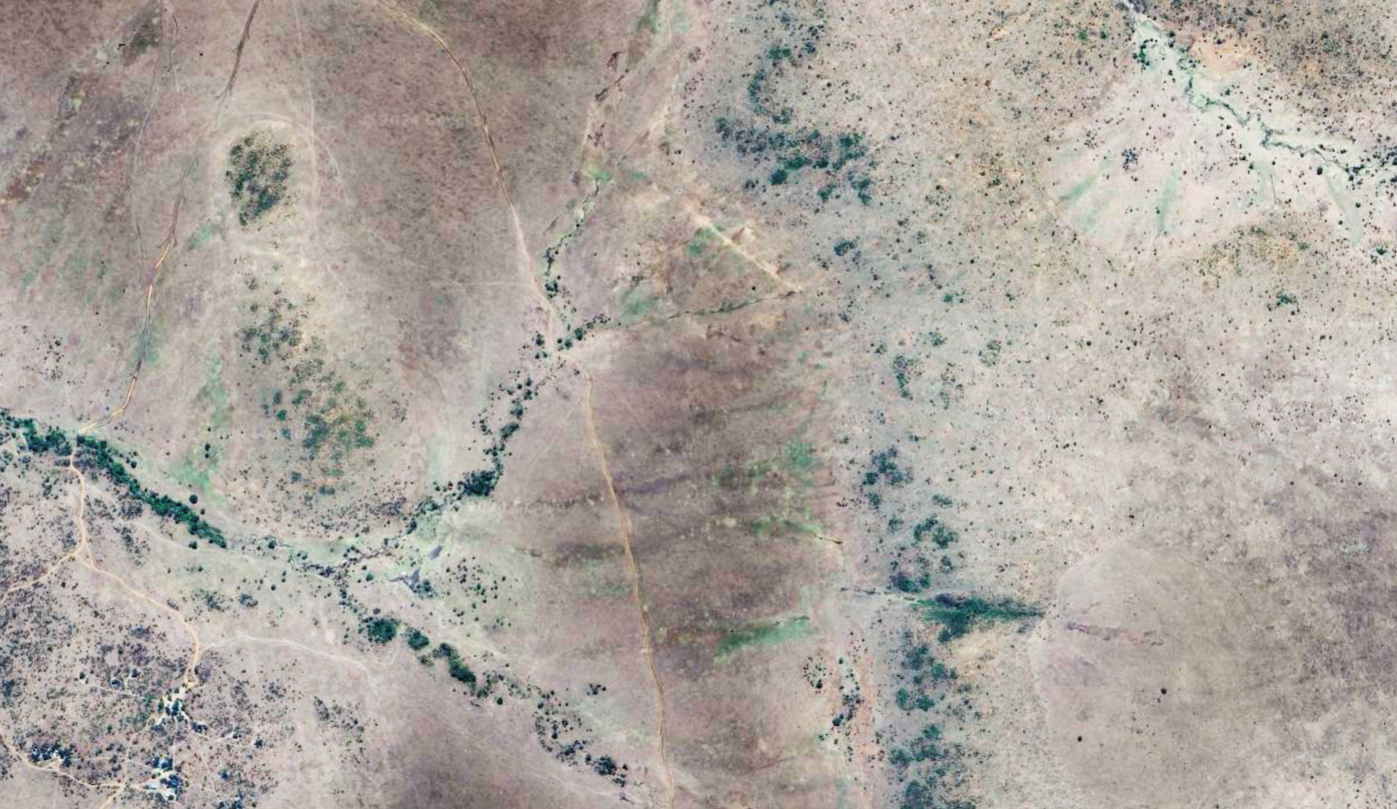
Complete Census
N = Number of Animals Counted
Notes:
How many animals are there? (64)
Assumptions? (We see every animal, no double-counting)

Slide 4
Strip Transects
N = ?
Notes:
Again, we still want to know the total number of animals in our reserve.
Strip transects allow us to survey just part of the area

Slide 5
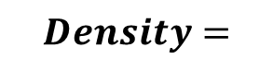
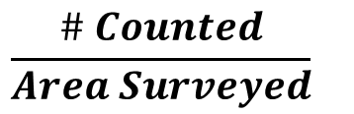
Strip Transects
$$\frac{\# Counted}{Area Surveyed}$$
$$Density=$$
Notes:
Who knows what I mean when I say “Density”?

Slide 6
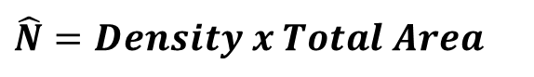
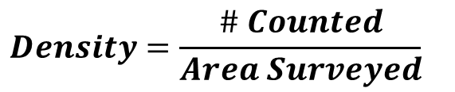
Strip Transects
$$Density=\frac{\# Counted}{Area Surveyed}$$
$$\hat{N}=Density x Total Area$$
Notes:
Who knows what I mean when I say “Density”?
Assumptions? 13 + 13

Slide 7
Strip Transects
$$Density=\frac{\# Counted}{Area Surveyed}$$
$$\hat{N}=Density x Total Area$$
Q2: If you surveyed 20 km² and your total area is 80 km², what is the density in your sampled area?
Notes:
Now, I want you to actually count the orange dots to answer this question
A2: 1.3 animals/km^2

Slide 8
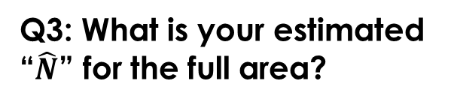
Strip Transects
$$Density=\frac{\# Counted}{Area Surveyed}$$
$$\hat{N}=Density x Total Area$$
Q2: If you surveyed 20 km² and your total area is 80 km², what is the density in your sampled area?
Q3: What is your estimated “$\hat{N}$” for the full area?
Notes:
A3: 1.3 x 80 = 104 animals

Slide 9
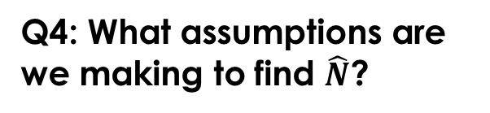
Strip Transects
$$Density=\frac{\# Counted}{Area Surveyed}$$
$$\hat{N}=Density x Total Area$$
Q2: If you surveyed 20 km² and your total area is 80 km², what is the density in your sampled area?
Q3: What is your estimated “$\hat{N}$” for the full area?
Q4: What assumptions are we making to find $\hat{N}$?
Notes:
A4:
All animals within the strip are counted (we don’t miss any, or systematically count “in” animals as “out” (or vice versa))
No double-counting
* To accurately estimate N, our transects must be a “representative sample” of the full area

Slide 10
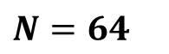
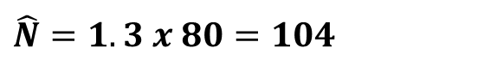
Strip Transects
$$Density=\frac{\# Counted}{Area Surveyed}$$
$$\hat{N}=Density x Total Area$$
$$\hat{N}=1.3 x 80=104$$
$$N=64$$
True Abundance
Q5: How could design our study so that observed density is more “representative”?
Notes:
A5:
more transects (maybe even more smaller transects)
systematic/random placement (e.g., here we are sampling areas with more woody vegetation)
Stratify by habitat types (e.g., some in open plains, some in shrub)

Slide 11
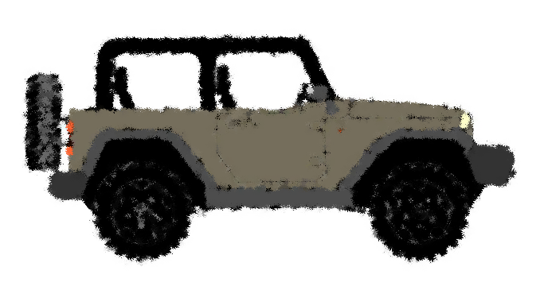
Title
Transect
Line
Cutoff Distance

Slide 12
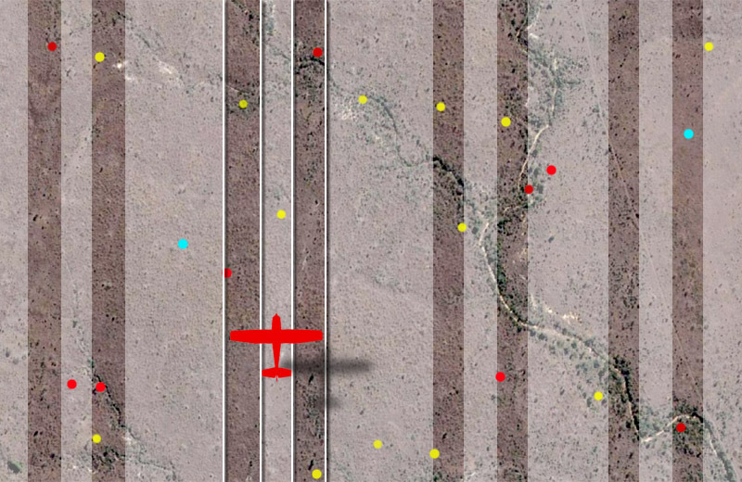

Slide 13
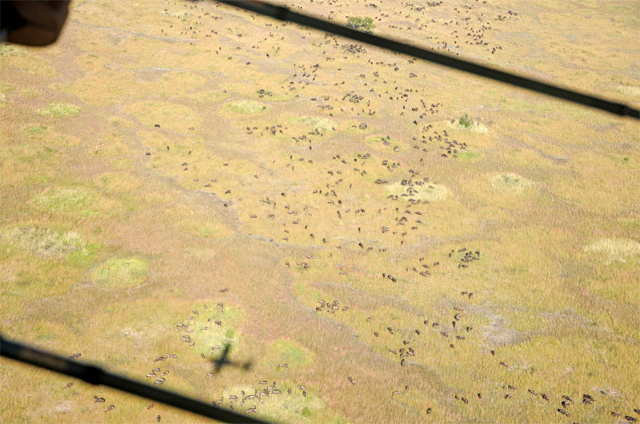
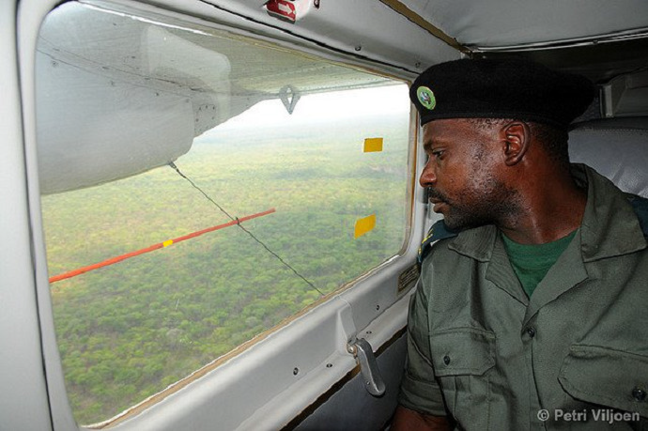
P. Viljoen
Notes:
762 total; 620 inside; 142 outside Liuwa Plain National Park, Zambia

Slide 14
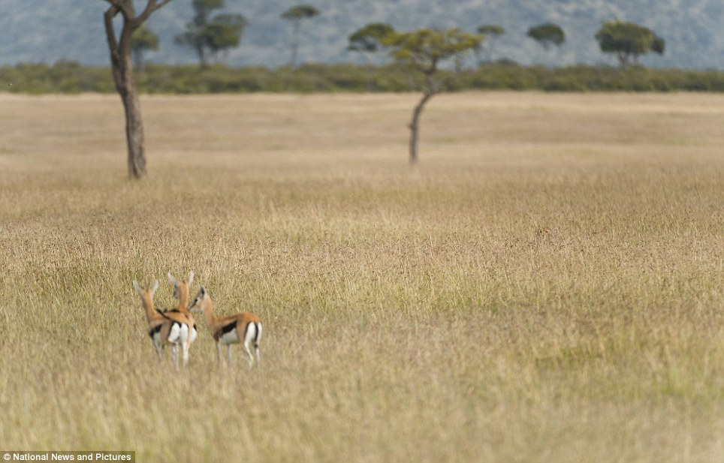
What if we miss some animals?
Photo credit: Richard Costin

Slide 15
What if we miss some animals?
Photo credit: Richard Costin
Notes:
Assumptions?

Slide 16
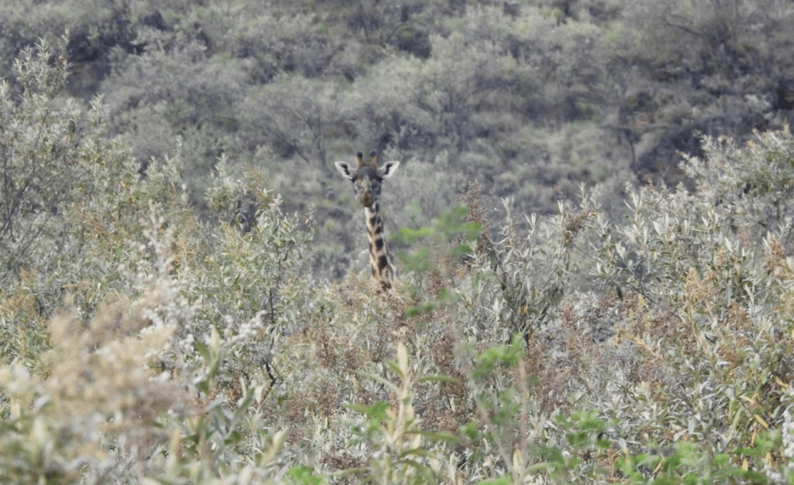
What if we miss some animals?
Q6: What factors make animals hard to see?
Q7: What happens to our estimates of D and $\hat{N}$ if we miss animals?
Photo credit: Janet Kavutha
Notes:
A6: Vegetation, terrain, distance, size, activity, lighting, observer
A7: We underestimate D and $\hat{N}.$ IMPORTANT: B/c of the factors we discussed, we may undercount more in certain areas or on certain days.

Slide 17
Why How do we count wildlife?

Slide 18
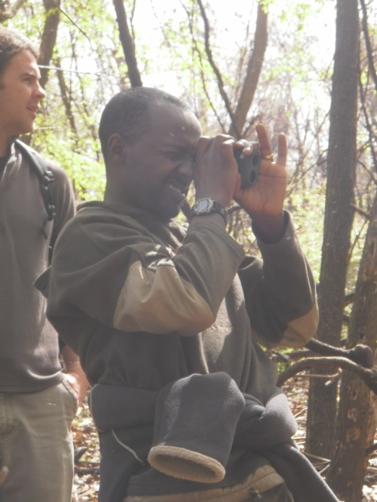
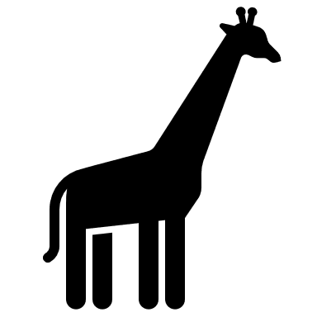
Basics of Distance Sampling
Estimating animal density by recording distances to fixed transect lines or points
d
Transect
Line

Slide 19
Basics of Distance Sampling
Estimating animal density by recording distances to fixed transect lines or points
Required data
Perpendicular distance (d)
OR Radial distance (r) and angle (Ѳ)
Transect length
Group size
r
d
Because d = r x sin(Ѳ)
Transect
Line
Ѳ

Slide 20
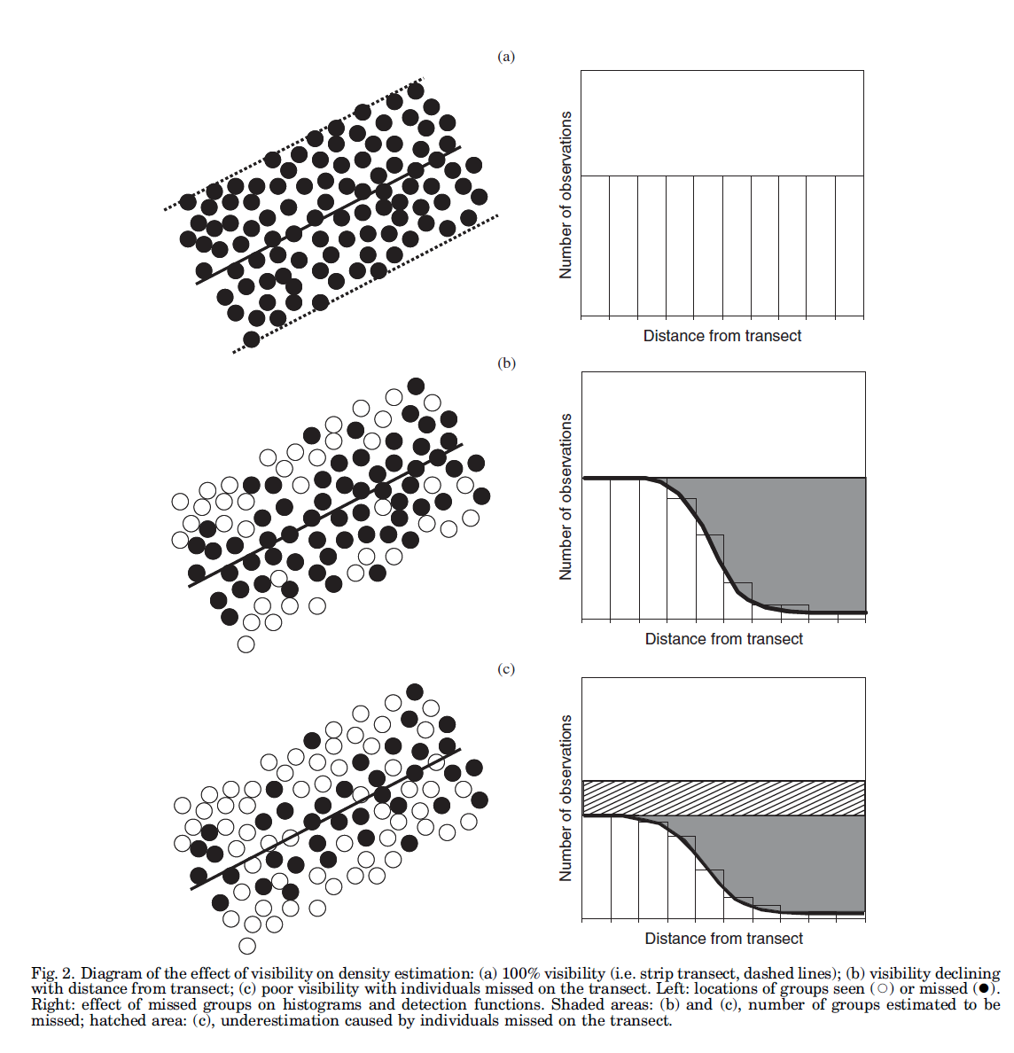
Why Bother with Distance Sampling?
Scenario A:
We detect every animal!
Likely open habitat + highly visible species
Scenario B:
Much more common!
More animals seen close to our transect line

Slide 21
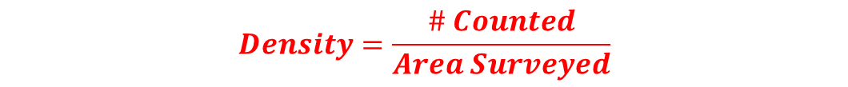
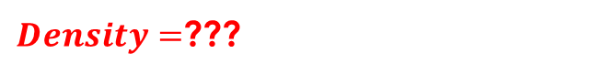
Why Bother with Distance Sampling?
Scenario A:
We detect every animal!
Likely open habitat + highly visible species
Scenario B:
Much more common!
More animals seen close to our transect line
Detection probability (p) = 1
Detection probability (p) < 1
$$Density=\frac{\# Counted}{Area Surveyed}$$
$Density=$???

Slide 22
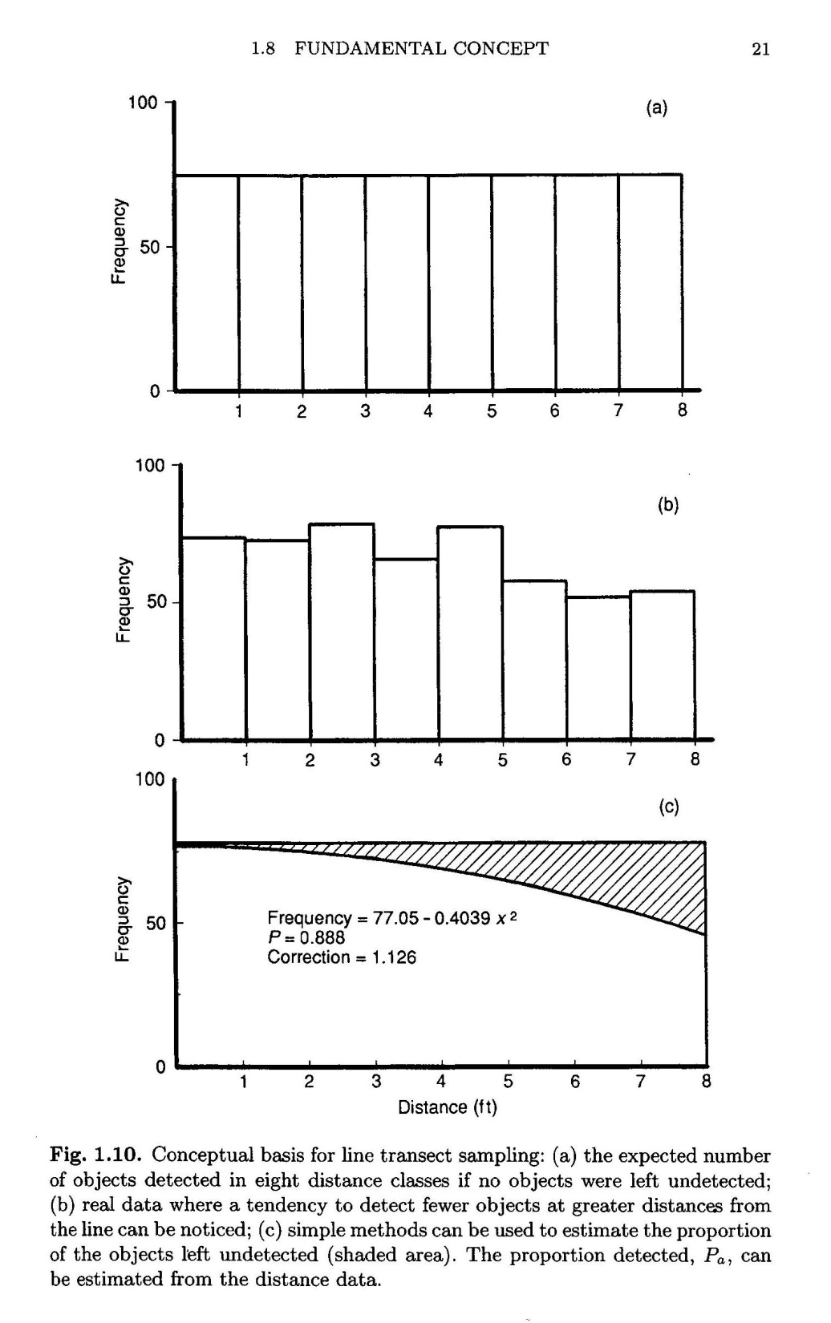


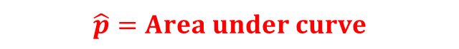
Detection probability (p) = 1
Detection probability (p) < 1
Estimated detection prob. ($\hat{p}$) = 0.65
$$\hat{p}=Area under curve$$
$$Distance sampling model$$

Slide 23

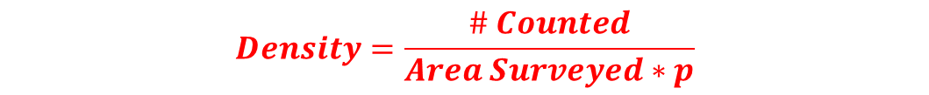

Why Bother with Distance Sampling?
Scenario A:
Scenario B:
Detection probability (p) = 1
Detection probability (p) = 0.65
$$Density=\frac{\# Counted}{Area Surveyed}$$
$Density=$???
$$Density=\frac{\# Counted}{Area Surveyed∗p}$$

Slide 24
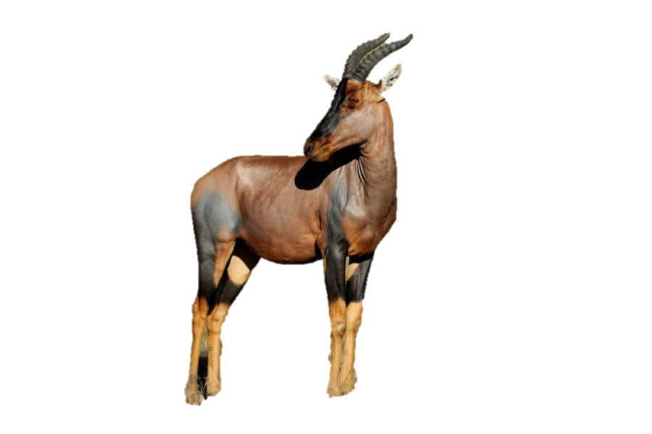
Distance Sampling Example
Q8: What is your estimate of D if you have the following data?
Transect area = 20 km²
# Counted = 61
Estimated detection = 0.65
Total area = 80 km²
Scenario B:
Q9: How many animals would you guess are in the transect area?
Q10: How many animals would you guess are in the total area?

Slide 25
Distance Sampling Example
Q8: What is your estimate of D if you have the following data?
Transect area = 20 km²
# Counted = 61 Topi
Estimated detection = 0.65
Total area = 80 km²
Scenario B:
$$D=\frac{61}{20}=3.05 Topi/km2$$
Q9: How many animals would you guess are in the transect area?
$3.05 Topi/km2 x 20 km2$ = 93.8 Topi (Truth = 100)
Q10: How many animals would you guess are in the total area?
Estimated N = $3.05 Topi/km2 x 80 km2$ = 244 Topi

Slide 26
Distance Sampling Example
Q11: Now imagine that each dot in Scenario B represents a group of Topi, not a single individual. If the average (mean) group size is 3.8 individuals, how many Topi would you estimate for your 80 km² area?
Transect area = 20 km²
# Counted = 61 Topi Groups
Mean Group Size = 3.8
Estimated detection = 0.65
Total area = 80 km²
Scenario B:

Slide 27
Distance Sampling Example
Q11: Now imagine that each dot in Scenario B represents a group of Topi, not a single individual. If the average (mean) group size is 3.8 individuals, how many Topi would you estimate for your 80 km² area?
Transect area = 20 km²
# Counted = 61 Topi Groups
Mean Group Size = 3.8
Estimated detection = 0.65
Total area = 80 km²
Scenario B:
Estimated N = $3.05\frac{Groups}{km2} x 80 km2$ $x 3.8\frac{Individuals}{Group}$ = 927 Topi

Slide 28
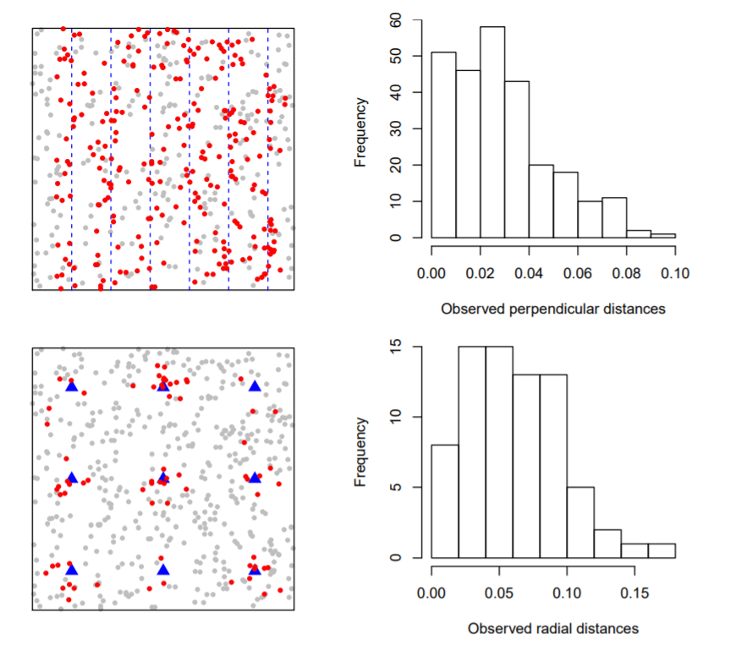
Line Transects
Point Transects
Miller et al 2019

Slide 29
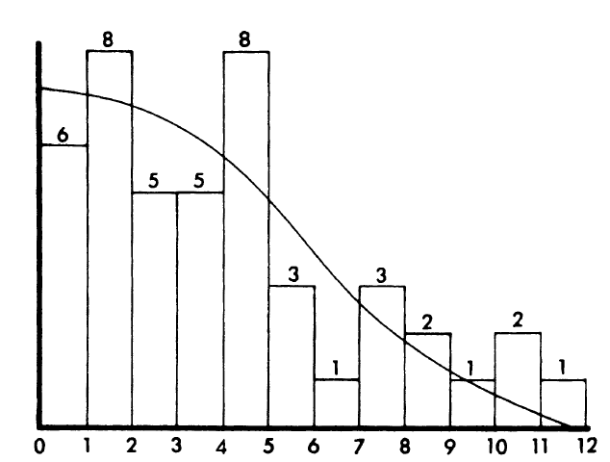
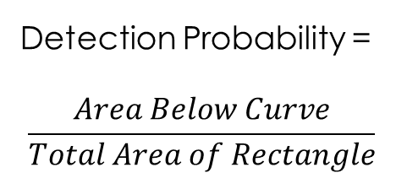
Summary of Distance Sampling Concepts
Number of animals seen/heard decreases at greater distances from the observer
If we understand how detection probability changes with distance, we can get much more reliable density/abundance estimates than we do with simple counts
Detection Probability =
$$\frac{Area Below Curve}{Total Area of Rectangle}$$

Slide 30
Study Design
Assumptions and Limitations
Objects on or near transects are detected with certainty
Objects should be measured from their initial location
Measurements should be exact
Sufficient sightings are recorded to estimate detection function
Sightings should be independent
Observer must walk faster than the animals
Transects should be placed at random with respect to the distribution of animals
Buckland et al. 1993, 2001, Burnham et al. 1980
Notes:
There are a range of assumptions associated with Distance Sampling and it makes sense to start there in talking about how to design a proper study.
g) Refers to avoiding things like placing transects on trails, along streams or rivers, ridgelines etc.
Let’s talk about the 4 primary and most important assumptions in more detail
See Buckland et al 2001 pp 29-37 for more detailed look at assumptions. Thomas et al 2010 discuss only f, a, and g.
See Rovero et al 2006 for inter-observer variation study

Slide 31
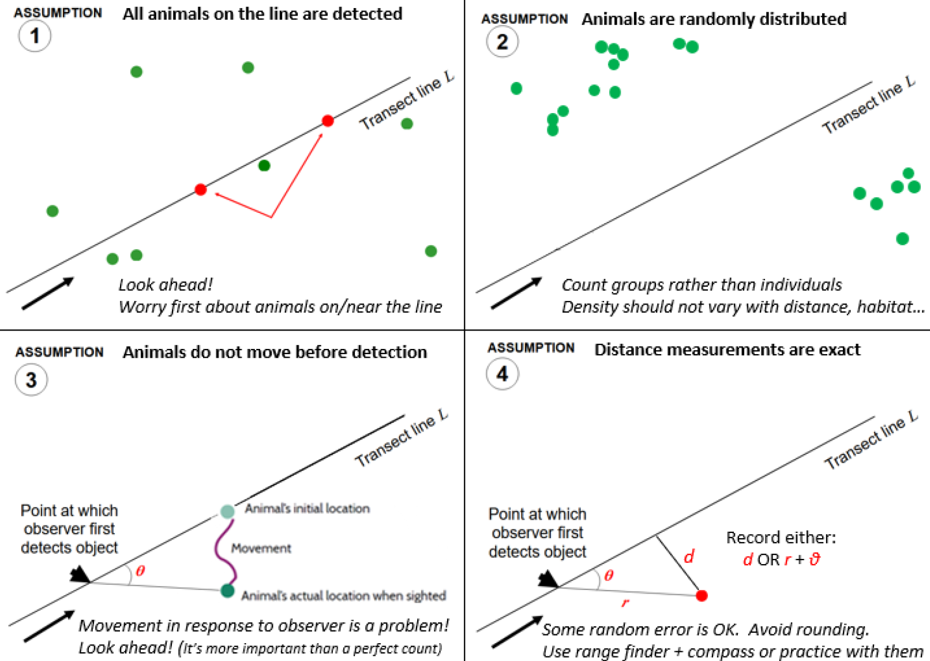

Slide 32
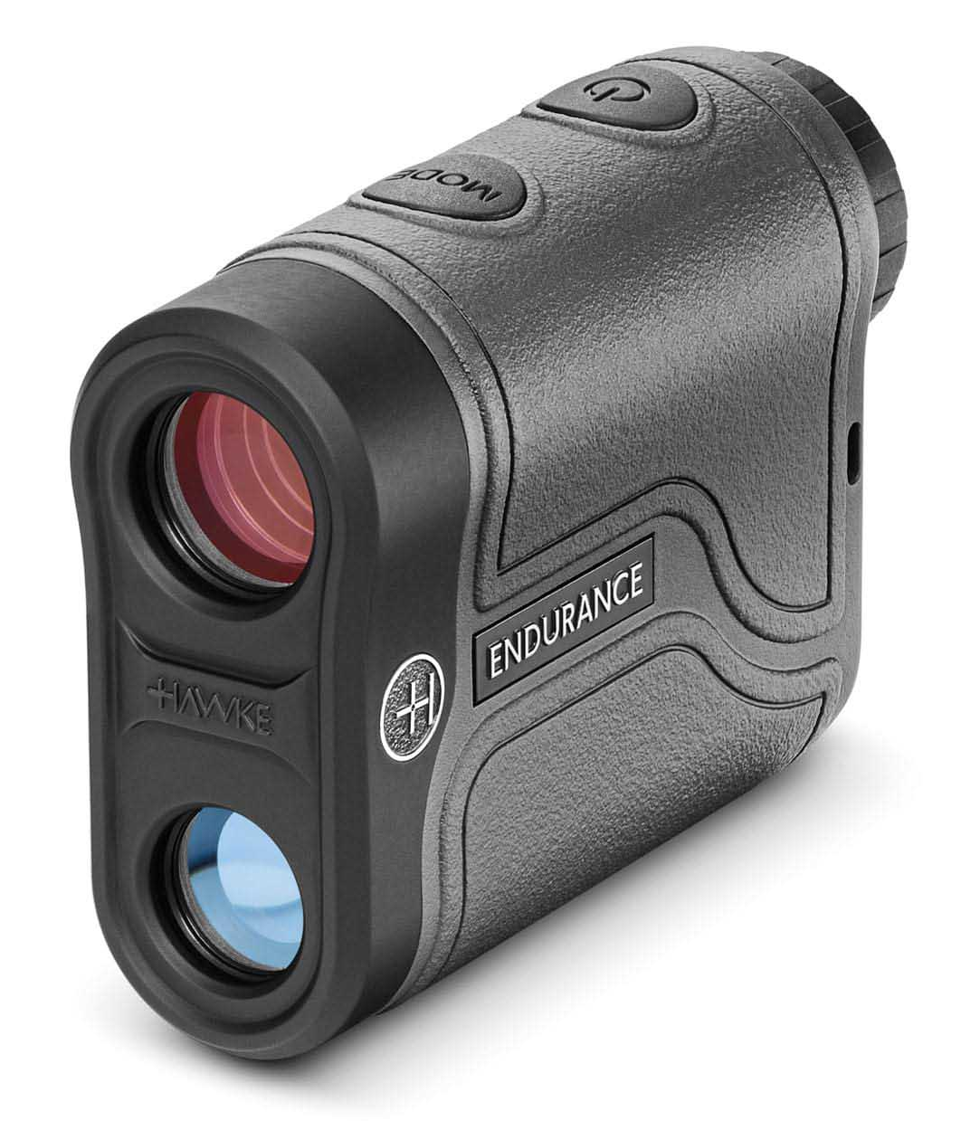

Distance Sampling Practice!

Slide 33
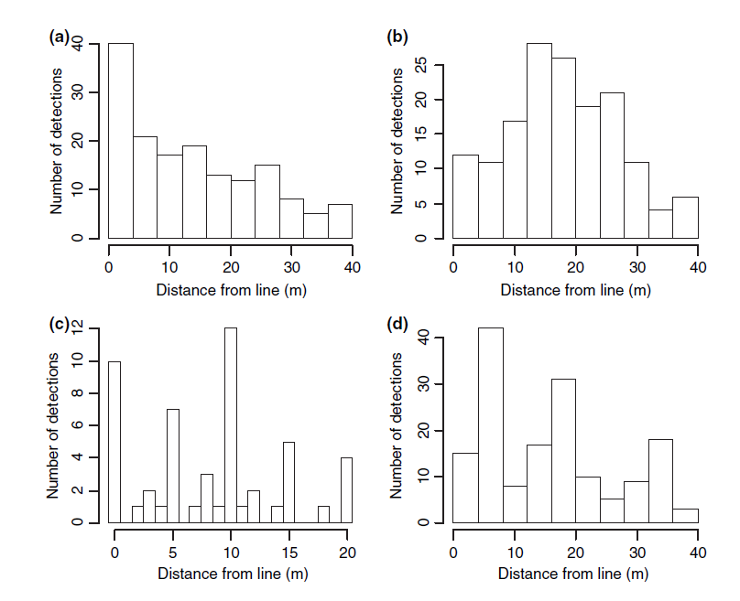
Notes:
Ask them why you might get these and see if they can figure it out.
We will cover design in more detail on Monday, for now I want you to get familiar with looking for issues in histograms
Spike at zero – animals attracted to observer, too much effort spent focusing on area in front of you.
Too few detections at zero – boat survey data can look like this when difficult to see the line. OR animal movement away from line/observer (HUNTED populations)
Rounding – more training or better equipment to avoid this. Judicious choice of cutpoints can help in curve fitting.
Overdispersion – animals occur in clusters but recorded as individuals, to avoid problems finding group center, or finding everyone in group. Remarkably robust to this violation of independence assumption, but model selection and variance estimation is compromised.

